Slide 1
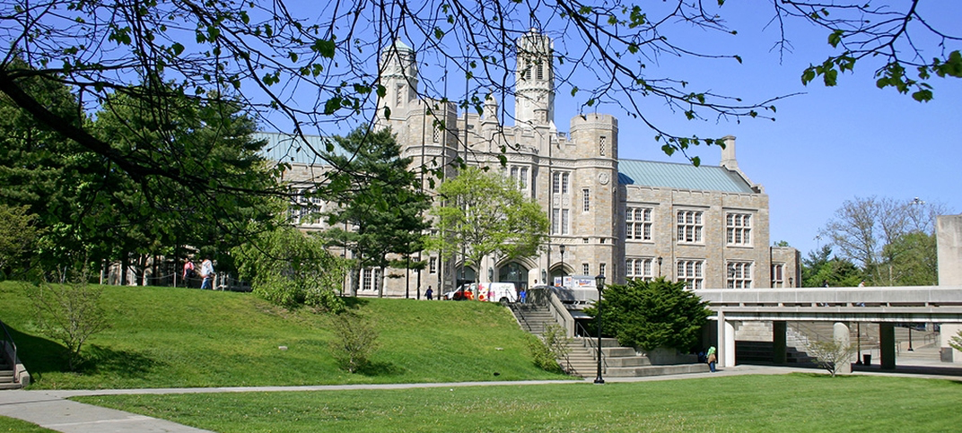





*New Course Offering*
Negotiation &
Conflict Management:
Learn to be a more effective negotiator
Tuesday Nights 6:15-8:45pm EST
Study any where in the world Via ZOOM Virtual Class
Course Description
This case-study-based course will prepare managers and business professionals responsible for planning, facilitating and managing company change initiatives, as well as identifying key business drivers that typically guide the need for organizational change. You’ll learn different techniques and interventions for working with resistance and encouraging innovation and transformation in various organizational settings.
REGISTER TODAY!

Slide 2
Doctor of Education, Organizational Leadership, Development and Change (EDOL)
The City University of New York
CONGRATUATIONS!
ENTER IN YOUR COMMENTS…

Slide 3
*New Course Offering*
Negotiation &
Conflict Management:
Learn to be a more effective negotiator
Tuesday Nights 6:15-8:45pm EST
Study any where in the world Via ZOOM Virtual Class
The City University of New York
Course Description
This course will help you better understand the theory, processes, and practices of negotiation, conflict resolution, and decision making in a work environment. The hands-on class format will empower you with real world experience to be a more effective negotiator in a wide variety of business situations.
REGISTER TODAY!

Slide 4
